Slide 1
Eduino Session 7

Slide 2
This is our last project book session
Congratulations on getting this far!
We’ve covered a great deal of material and you have encountered most of the fundamental concepts in electronics.
The rest of this presentation we will recap on previous sessions.

Slide 3
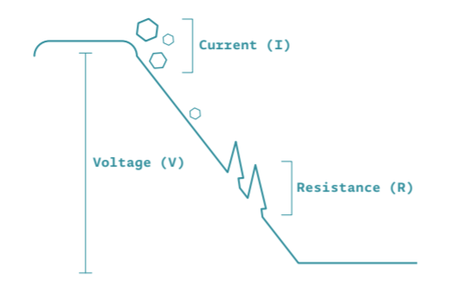
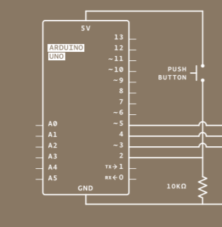
Session 2: Resistors
1.) What is Ohm’s law?
2.) What value resistor do we need to light a single LED from the Arduino’s 5V output?
3.) Why do we use a 10K ohm resistor in the circuit on the right? (Project 02)

Slide 4
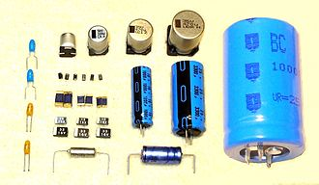
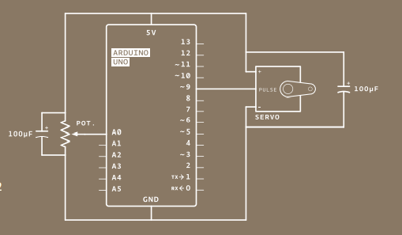
Session 3: Capacitors
1.) What is a capacitor?
2.) How are capacitors made?
3.) What is the purpose of the two capacitors in the circuit to the right (Project 05)?

Slide 5
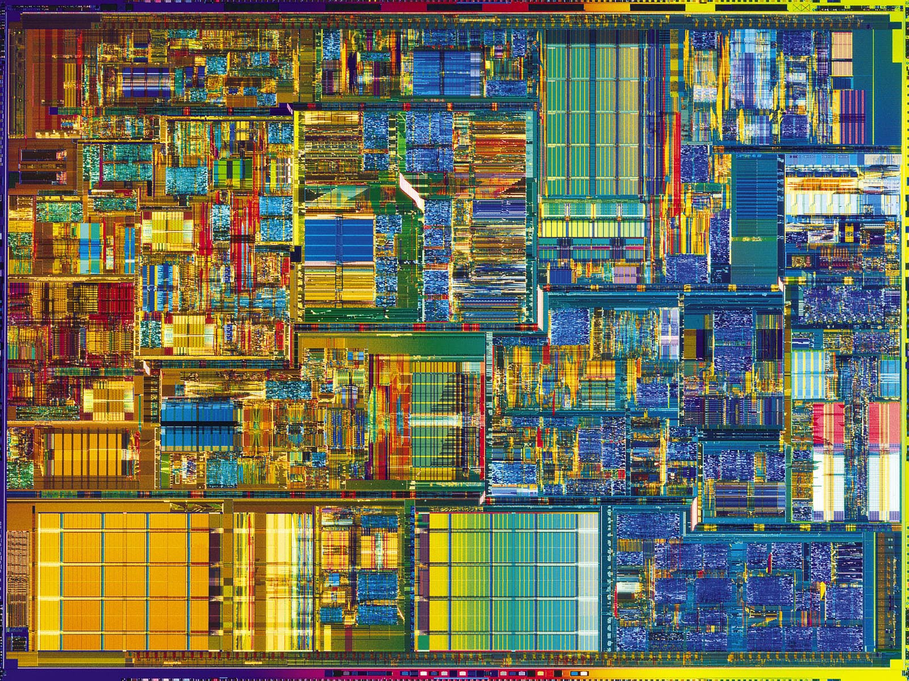
Session 4: Variables and Datatypes
1.) How many bits are a byte?
2.) How many values can we represent with a byte?
3.) What values can be stored by an int variable?
4.) Look at the array on the left.
myArray[9] = ?
Notes:
1.) 8
2.) 256
3.) -32,768 and 32,767
4.) 11

Slide 6


Session 5: Transistors and ICs?
1.) Complete the sentence
“For a NPN transistor, the more current we apply to the base… the ____ electricity will flow between the collector and emitter.”
2.) Name two common applications for transistors.
3.) What is an IC?
4.) Can you name some common types of IC?

Slide 7
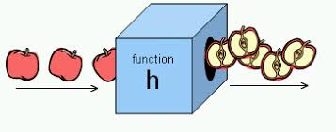
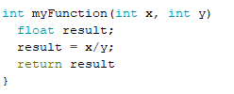
Session 6: Functions
1.) Why do we use functions?
2.) What does it mean if a function is declared as void()?
3.) Identify three errors in the function declaration below:

Slide 8
For next session …
Present an idea for your own Arduino project.
Your idea will change as you begin to develop it further. Don’t worry about fleshing out all the details right now.
Not sure where to start? Focus on one of the projects we have done so far that you have enjoyed.
What new features would it be interesting to add?
How could this project relate to your studies/hobbies?

