Slide 1
Functions

Slide 2
Learning objectives
Understand what a function is.
Understand why we write our own functions in programming.
Understand how to write a function in C.

Slide 3
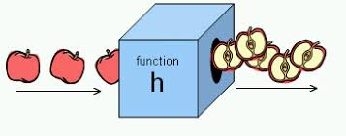
What is a function?
Functions are segments of code that perform a defined task and then return to the area of code from where they were run.
Functions can have multiple inputs but only one output.
Functions don’t need to have inputs or outputs.
Notes:
Image credit: https://courses.lumenlearning.com/boundless-algebra/chapter/introduction-to-functions/

Slide 4
Examples of functions
Map function (project 05) is used to convert the potentiometer value to an angle between 0 and 179. It takes 5 inputs and has one output.
Tone function (project 6) is used to sound a buzzer, it takes 3 inputs. No output.
Millis function (project 8) is used to tell how long the Arduino has been running. It takes no inputs and has one output.

Slide 5
Why write our own functions?
Saves time and space – if there is a task we want to perform repeatedly, we don’t have to keep writing out long segments of code.
Reduces the chance of error - the less code we have to write, the less chance of error.
Modularity – we can reuse functions we have written for one sketch in another sketch.

Slide 6
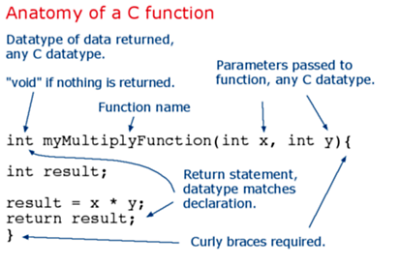
How do we write our own functions?
Notes:
Image credit: https://www.arduino.cc/en/Reference/FunctionDeclaration

