Slide 1
Functions

Slide 2
Learning objectives
Understand the roles of a transistor in an electronic circuit.
Know what is meant by an integrated circuit, and why we use them.

Slide 3
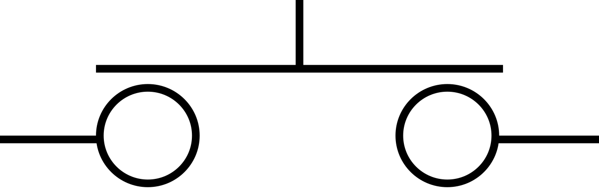
Transistors
Transistors can be thought of as electronic switches or amplifiers.
Imagine a mechanical switch…
Physical pressure
Electricity
Notes:
https://learn.adafruit.com/transistors-101

Slide 4
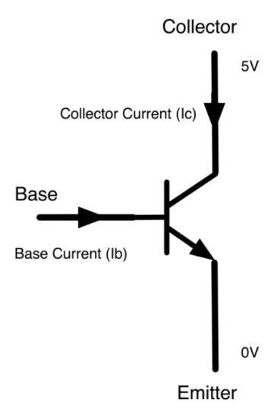
Transistors
Transistors can be thought of as electronic switches or amplifiers.
The more current we apply to the base… the
more electricity will flow between the collector and emitter.
Electricity
Apply a current
Notes:
https://learn.adafruit.com/transistors-101

Slide 5
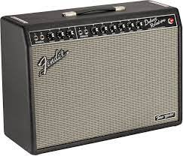
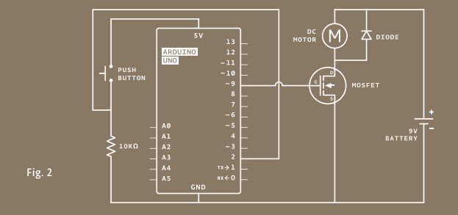
Why are transistors useful?
As amplifiers transistors allow us to use a small current to control a much larger current.
This is used in audio amplifiers, like guitar amps, to make loud music.
In project 09 motorized pinwheel we used a transistor to allow the Arduino to control a DC motor.
The Arduino cannot provide enough current to spin the motor on its own. However, a 9-v battery can. A transistor allows the Arduino to control when current flows to the motor from the 9-v battery.
Notes:
Note: the battery does not power the Arduino.

Slide 6


Why are transistors useful?
As electric switches transistors allow us to store information (remember last week’s talk on variables and datatypes) and perform computation.
Transistors are the key component of the modern digital world. You are all using billions of transistors to watch this presentation.
If transistors do not have to do supply high power, they can be made very small. IBM have recently developed a 2 nm transistor. They can fit 50 billion transistors on a chip the size of a fingernail.
Many transistors use an element called silicon to work. Hence silicon valley is the home of many tech companies.
Transistors are a key component in integrated circuits in electronic devices.
Notes:
https://newatlas.com/computers/ibm-2-nm-chips-transistors/
2 nm, take the length of your finger nail and make it 10 times smaller, then 1000 times smaller, then 1000 smaller again.

Slide 7
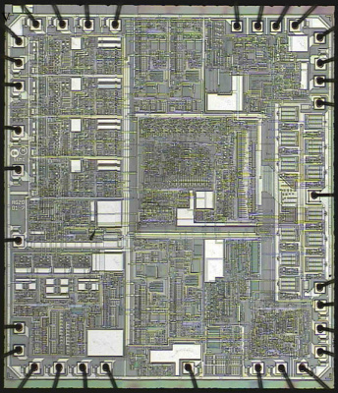
Integrated Circuits
An Integrated Circuit (IC) is a miniaturized circuit. It consists of a collection of components (capacitors, resistors, transistors etc.)
It consists of a complex etching of copper and silicon (known as a die) which interconnect with the components to form a circuit.
ICs allow us to take insert pre-made circuits in our circuits, which saves us time and space.
IC Die

Slide 8
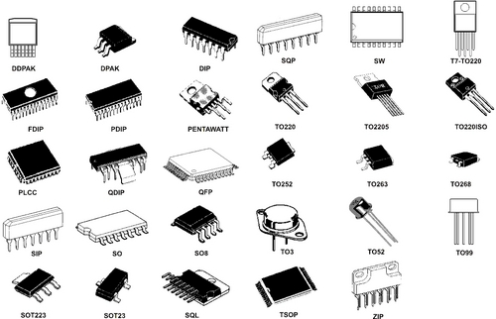
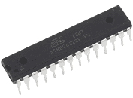
Integrated Circuits
There are many types of IC available which serve different purposes and are of varying complexity.
Examples include, logic gates, timers, sensors, all the way to microcontrollers (like the one in your Arduino!).

Slide 9
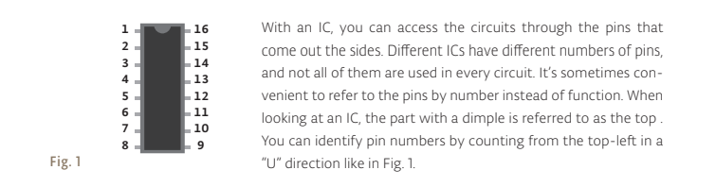
Integrated Circuits
In project 10 we will be using an IC known as an H-Bridge. We will learn how to connect an IC into our circuit using its pins.
ICs are polarized so it matters which way round we put them.

Slide 10
Can you answer these questions?
How does a transistor work?
What are common applications of transistors?
What is meant by an integrated circuit?
What are common types of integrated circuit?

Slide 11
Recommended resources
This presentation has been a very brief overview of a fundamental aspect of electronics. I encourage you to keep learning!
Make presents the transistor: https://youtu.be/-td7YT-Pums
Adafruit transistors 101: https://learn.adafruit.com/transistors-101
Spark fun integrated circuits: https://learn.sparkfun.com/tutorials/integrated-circuits/all
Notes:
https://youtu.be/-td7YT-Pums – Make the transistor

