Slide 1
Variables and data types

Slide 2
Learning objectives
Understand what variables are and why we use them in code.
Understand how variables are stored on the Arduino.
Summarize the different types of variables that we use in Arduino programming.

Slide 3

Variables
A variable is used to store information that can be referenced in computer programming.
Variables make computer programs easier to work with:
Instead of writing out long numbers or lines of text repeatedly, we can store them with an easy to remember name.
When we are running code in a loop, variables can be used to store readings from a sensor and update them continually.
Variables make our code easier to read.

Slide 4
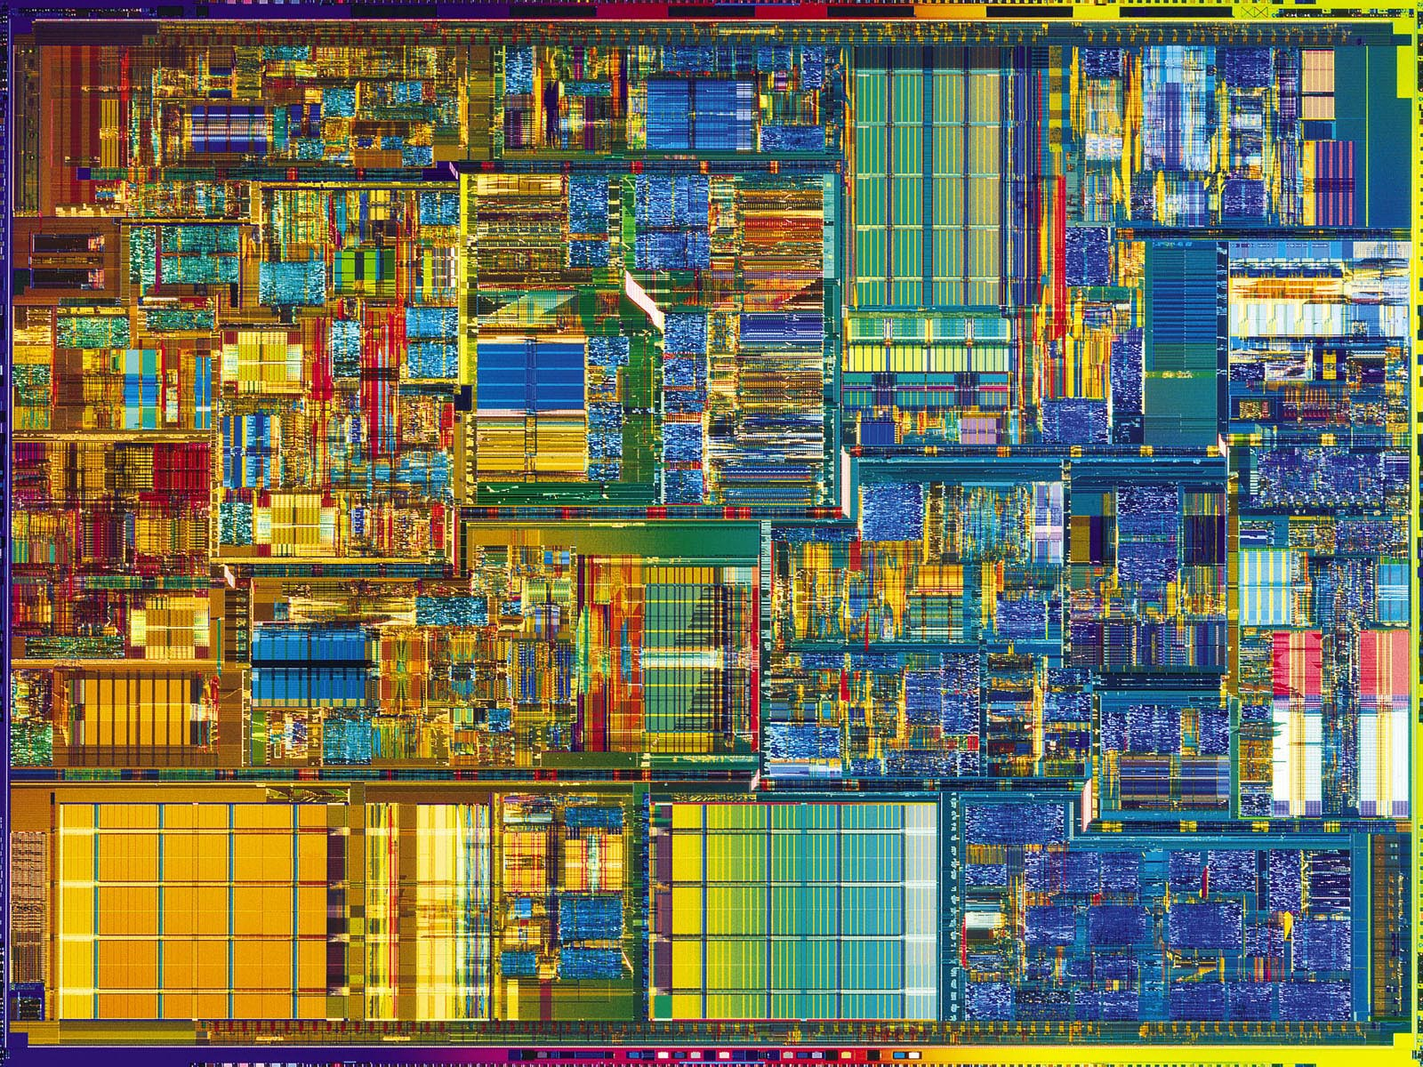
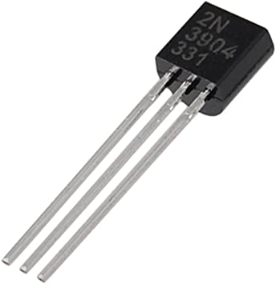
How variables are stored
Arduino stores variables (and all other data) using special components called transistors.
Transistors act as electrical switches. They can either be ON (1) or OFF (0).
Variables are stored as a series of 1s and 0s. This is known as binary.
The microchip in your Arduino contains ~ 100,000 transistors
With two transistors we can make 4 numbers.
0
0
=
0
0
1
=
1
1
0
=
2
1
1
=
3
Notes:
Transistors are without a doubt one of the most important inventions of the modern world. We will cover them in more detailed in the next session.
The latest iPhone contained over 8 billion transistors.

Slide 5
How variables are stored
In computer science bits and bytes are used to refer to the number of 1s and 0s used to store data.
A bit stores just 1 or 0. It is the smallest unit of storage (e.g., 1 transistor).
A byte is a collection of 8 bits.
How many values can we represent with a byte?
2⁸ = 256 values
(00000000) = 0
(11111111) = 255
Notes:
For more reading see: https://web.stanford.edu/class/cs101/bits-bytes.html

Slide 6
Variable types in Arduino - Numbers
Byte – an 8-bit whole number. Used to store unsigned values between 0 and 255.
Int – a 16-bit whole number. Used to store signed values between -32,768 and 32,767. (2¹⁶ = 65536).
Long – a 32-bit whole number. Used to stored signed values between -2147,483,648 and 2,147,483,647 .
Unsigned Long a 32-bit whole number. Used to stored unsigned values between 0 and 4,294,967,295 (2³² = 4,294,967,296).
Float a 32-bit number that has a decimal point. They have 6-7 digits of precision. Used to store decimal numbers (e.g. 2.9, 123.193 …). Slow!
Notes:
https://www.arduino.cc/reference/en/language/variables/data-types/byte/
https://www.arduino.cc/reference/en/language/variables/data-types/char/
https://www.arduino.cc/reference/en/language/variables/data-types/int/
https://www.arduino.cc/reference/en/language/variables/data-types/float/

Slide 7
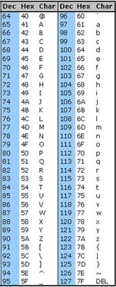

Variable types in Arduino – Letters and Arrays
Char – an 8-bit value used to store letters or symbols. Numbers between 0 and 255 are converted to text based on the ASCII chart.
Array – used to store a series of variables! Stored variables can be indexed by their position in the array.
Notes:
ASCII American Standard Code for Information Interchange

Slide 8
Can you answer these questions?
What is a variable?
Why do we use variables in code?
How are variables stored on the Arduino?
How many bits are in an int variable?
What values are stored by an unsigned int variable?

