Slide 1
Eduino Session 3
Capacitors

Slide 2
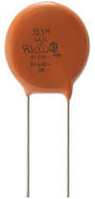
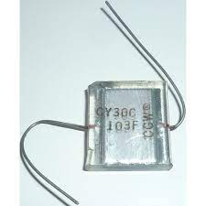
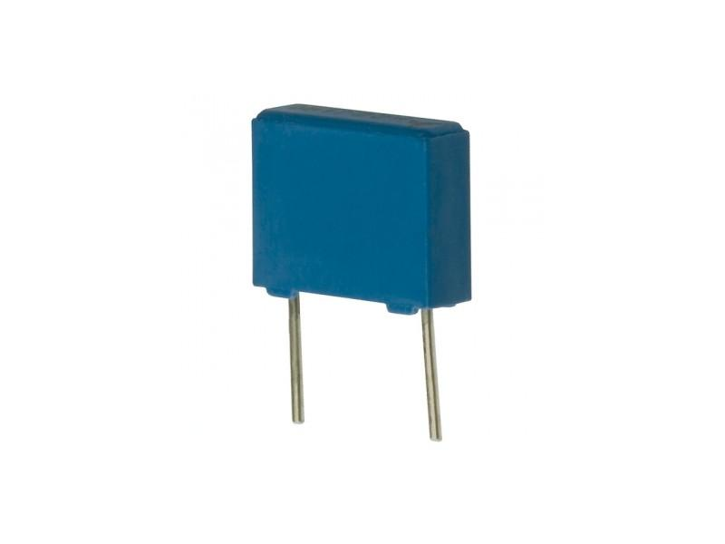
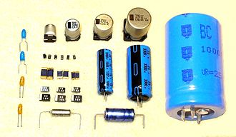
Capacitors
Capacitors are two terminal components that stores electric charge.
The amount of charge a capacitor can store at a given voltage is known as capacitance and is measured in farads (f).
Capacitors consist of two conducting plates separated by an insulating material. The thicker the insulating material the higher the capacitance.
Capacitors come in many forms and sizes:
Ceramic
Glass
Plastic
Electrolytic – polarized!
Notes:
Recommended reading:
https://learn.adafruit.com/circuit-playground-c-is-for-capacitor/what-is-a-capacitor

Slide 3
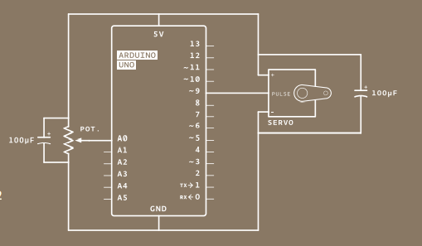
Why do we use capacitors?
Decoupling capacitors used in exercise 5.
Decoupling capacitors smooth out undesired changes in voltage.
Block direct current (DC)
Filter out high frequency alternating current (AC) signals.
Create resonance circuits, used to tune radios to particular frequencies.
Notes:
Recommended watching:
https://youtu.be/ZYH9dGl4gUE

