Slide 1
Eduino Session 2 Recap Resistors
03/07/2021
Notes:
http://www.falstad.com/circuit/circuitjs.html

Slide 2
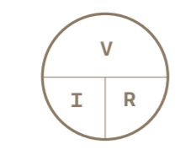
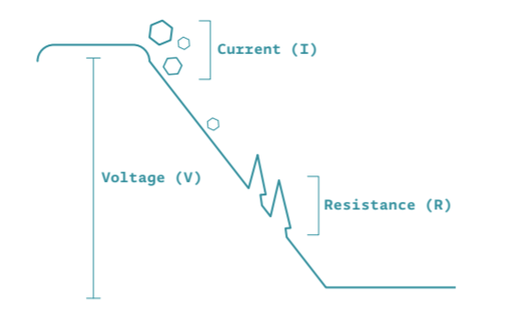
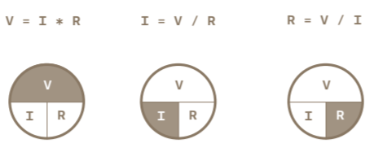
Exercise 1: Get to Know your Tools
Voltage (volts) is the difference in energy between one point in a circuit and another
Current (amps) is the amount of electrical charge flowing past a specific point in your circuit
Resistance (ohms) is how much a component resists the flow of electrical energy.
Notes:
When we say the Arduino is 5 volts, we mean there is 5 volts difference between the 5v power pin and the ground. This difference is only

Slide 3
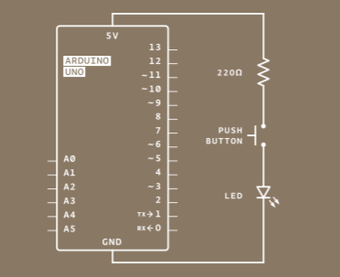
Exercise 1: Get to Know your Tools
Why 220 ohm resistor?
-3v
LEDs typically require 10 to 20 mA (0.01 or 0.02 A)
LEDs have a forward voltage of ~ 2 V.
-2v
5 – 2 / 0.02 = 150 Ohms
5 – 2 / 0.01 = 300 Ohms
We need a resistor between 150 and 300 Ohms.
Notes:
Show html circuit

Slide 4
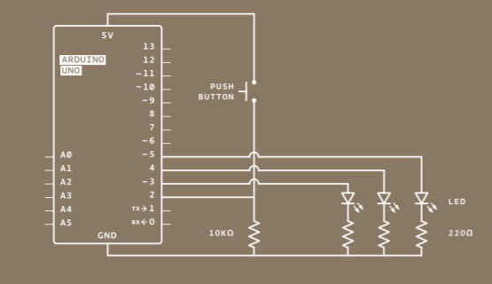
Exercise 2: Spaceship interface
Pin 2 is being used to perform digital read
If there was no resistor it might detect a current in the
environment even if the button wasn’t pressed.
Why 10k ohm resistor?

